Slide 1
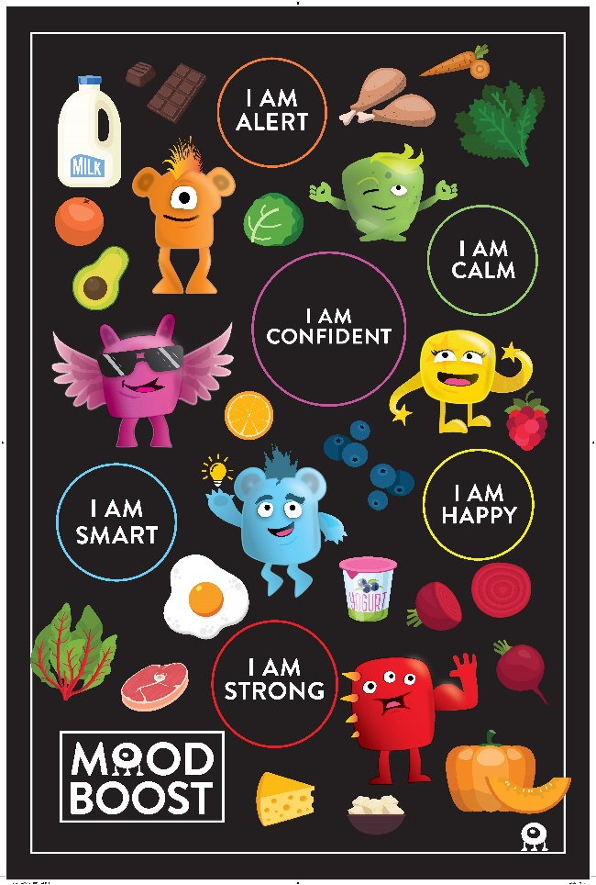
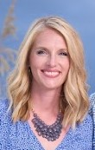


February Food Service Newsletter
Kimberly Area School District’s Monthly Newsletter
Mood Boost is Back at Elementary & Intermediate Schools!
Designed to help students make the connection between what they eat and how they feel, Mood Boost brings new menu items, samples, and “Moodie” characters into our cafeterias.
Be on the lookout for new menu items, recipe handouts and giveaways at Elementary & Intermediate school cafeterias!
In this issue:
What's New in your Schools?
Looking for Menus?
Did you know all our menus are available on Nutrislice, an interactive website and free smartphone app?
Better Together: Team Member Spotlight
Go to Kimberly.nutrislice.com
Click “View Menus”
Select grade level, school and the menu you want to see.
View the current day’s menu or skip to a future date.
Select a food to find its description and photo, filter by allergens, print the menu and so much more!
Events to Look Forward to this Month
MIRANDA PRISLAND, RD
DIRECTOR OF DINING SERVICES
920-687-3024 OPTION 5
mprisland@kimberly.k12.wi.us

Slide 2
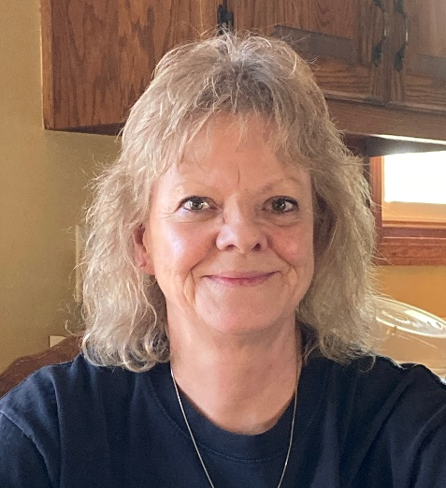
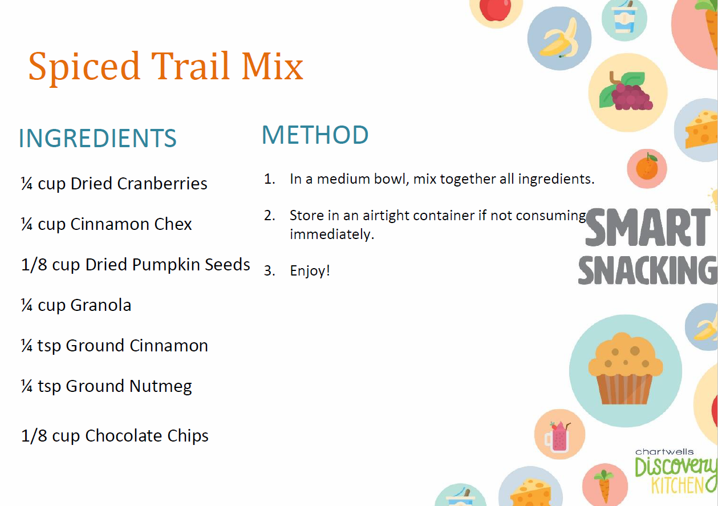

Smart Snacking
There’s no question that students today are busier than ever! With school, sports and other extra-curricular activities, we want to ensure students understand how healthy snacks and meals can be an important part in keeping them energized all day long.
Try this recipe to provide energy and keep hunger at bay between meals.
Team Member Spotlight:
Jackie Breese,
Cashier, Sunrise Elementary
Hometown: Appleton, WI
Food Service/Experience:
Jackie has worked in food service positions for over 50 years!
Favorite Food:
Steak & Fish
Length of Service: 2 ½ years
Fun Fact: Jackie enjoys camping and spending time with grandkids and friends.
Favorite activity at Sunrise: Jackie loves wearing her Mood Boost shirt and having fun with the students. She makes sure the students have a great day!
What do I like about working with Chartwells?:
Jackie loves interacting with the Sunrise students and staff every day. They are a blessing to her job. She loves having the summers off as well.
Events to look forward to
March 2:
Dr. Seuss’s Birthday at Elementary & Intermediate Schools
March 17:
St. Patrick’s Day, Lucky Tray Day at Elementary & Intermediate Schools
March 21:
Student Choice Event at JR Gerritts

